Slide 1



Engineering Ethics (HSS-422) (3+0)
ENGR. SYED RIZWAN ALI
Assistant Professor,
Head of Business Incubation Center,
Bahria University (Karachi Campus)

Slide 2
A FRAMEWORK FOR ETHICAL DECISION MAKING
Engineering Ethics (HSS-422) (3+0)
Week No 06
By Engr. Syed Rizwan Ali
Notes:
More Discussion about of the Lecture

Slide 3
Learning Outcomes
In this Lecture will cover ..
Understand the Fundamentals of Ethical Decision Making.
Identify and Recognize Ethical Issues.
Effective Information Gathering for Ethical Decision Making.
Apply Ethical Decision-Making Frameworks.
Implement Ethical Practices in Professional Settings.

Slide 4

A FRAMEWORK FOR ETHICAL DECISION MAKING

Slide 5
Introduction to Ethical Decision Making
Key Terms:
Ethics: The principles of right and wrong that guide an individual in making decisions. Ethics involve considerations of fairness, equity, respect for others, and the inherent dignity of all individuals.
Decision Making (DM): The process of selecting DM from several alternatives. In a professional context, DM is often involves weighing various factors, including potential outcomes, values, and ethical implications.

Slide 6
Introduction to Ethical Decision Making
Background:
An ethical issue is a situation or problem that requires an individual or organization to choose between alternatives that must be evaluated as right (ethical) or wrong (unethical).
Ethical decision making is crucial in professional settings as it underpins the integrity and success of an organization. It involves choosing actions that are not only legally compliant but also morally right, reflecting the organization’s values and respect for stakeholders.

Slide 7
Introduction to Ethical Decision Making
Background:
Ethical decisions contribute to a positive organizational culture, enhance reputation, and build trust with employees, customers, and the wider community.
In the long term, ethical decision-making drives sustainable business practices and mitigates risks associated with unethical behavior.

Slide 8
Introduction to Ethical Decision Making
Recognize an Ethical Issue:
Identification of Ethical Dilemmas: Involves recognizing situations where a decision has significant moral implications. This is the first step in the ethical decision-making process and requires an awareness of how one’s actions affect others and the broader environment.
Ethical dilemmas often present themselves as conflicts between competing values or interests, where the right course of action is not immediately clear.

Slide 9
Introduction to Ethical Decision Making
Workplace Examples:
A manager facing a choice between laying off a small number of employees or cutting salaries for the entire team to reduce budget expenditures.
A salesperson considering whether to omit or downplay negative information about a product to close a sale.
An executive deciding whether to invest in environmentally sustainable, yet more costly, production methods.

Slide 10
Introduction to Ethical Decision Making
Workplace Examples:
A healthcare professional balancing patient confidentiality with the need to inform family members about a patient’s health condition.

Slide 11
Get the Facts
Importance of Gathering Information:
Tips on How to Collect Facts:
Who to Talk To
Tips on How to Collect Facts:
What to Ask:
Tips on How to Collect Facts:
Where to Find Information:

Slide 12
Get the Facts
Importance of Gathering Information:
Gathering all relevant information is a fundamental step in the ethical decision-making process. Before making a decision, it is crucial to understand the full context of the situation, including the potential impact on all stakeholders.
Collecting comprehensive information ensures that decisions are made based on a well-rounded understanding of the issues at hand, leading to effective outcomes.

Slide 13
Get the Facts
Tips on How to Collect Facts:
Who to Talk To:
Engage with all parties directly affected by the decision to get a diverse range of perspectives.
Consult with experts or individuals with experience in similar situations to gain insights into potential implications and solutions.

Slide 14
Get the Facts
Tips on How to Collect Facts:
What to Ask:
Inquire about the specific details of the situation, including who will be impacted and how.
Ask open-ended questions to encourage thorough and thoughtful responses.
Seek clarity on any legal, financial, or operational constraints that may influence the decision.

Slide 15
Get the Facts
Tips on How to Collect Facts:
Where to Find Information:
Review relevant documents, such as company policies, industry standards, legal guidelines, and past precedent.
Utilize credible sources of information, including academic research, professional organizations, and industry publications, to understand broader ethical considerations and trends.

Slide 16
Get the Facts
Tips on How to Collect Facts:
Where to Find Information:
Explore online databases and libraries to gather historical data, case studies, and other relevant materials that can inform the decision-making process.

Slide 17
Importance of Recognizing Ethical Issues
The importance of recognizing ethical issues early in the decision-making process cannot be overstated, as it is fundamental to ensuring responsible decision-making and maintaining the integrity of professional practices.
Early recognition allows individuals and organizations to proactively address moral dilemmas before they escalate, promoting a culture of transparency and accountability.

Slide 18

Importance of Recognizing Ethical Issues
For Example: A situation involving conflicts of interest, potential harm to people and the environment, legal concerns, and violations of company policy and public standards of decency is the Volkswagen emissions scandal.

Slide 19
Importance of Recognizing Ethical Issues
In this case, Volkswagen engineers installed software in diesel engines to cheat on emissions tests, allowing the vehicles to meet regulatory standards during testing while emitting up to 40 times the legally allowed limit of nitrogen oxides during regular driving.
This action represented a conflict of interest as the company prioritized financial gains and market dominance over environmental responsibility and public health.

Slide 20
Importance of Recognizing Ethical Issues
The deceit not only caused significant environmental damage but also violated numerous legal standards globally, leading to billions of dollars in fines and settlements.
Additionally, it breached the company’s own policies on ethical conduct and corporate responsibility, severely damaging Volkswagen’s reputation and eroding public trust.

Slide 21
Importance of Recognizing Ethical Issues
This scandal illustrates the complex interplay of ethical issues, including conflicts of interest, legal violations, and the broader impact on society and the environment.

Slide 22
Lists of the Common Indicators
Here are common indicators that a situation might have ethical implications:
Conflict of Interest: Situations where personal interests could influence professional judgment or actions.
Confidentiality Breaches: Instances where private or sensitive information is at risk of unauthorized disclosure.
Inequality or Discrimination: Actions or decisions that unfairly favor or disadvantage specific groups or individuals

Slide 23
Lists of the Common Indicators
Legal Compliance Issues: Circumstances that may violate laws, regulations, or industry standards.
Financial Misconduct: Situations involving bribery, embezzlement, fraud, or other financial irregularities.
Misuse of Resources: Inappropriate or unethical use of company assets or resources for personal gain.

Slide 24
Lists of the Common Indicators
Unfair Treatment of Employees: Practices that undermine employee rights, such as harassment, bullying, or exploitation.
Safety Violations: Actions or conditions that compromise the safety and well-being of individuals.
Environmental Harm: Decisions or actions that have a negative impact on the environment or violate environmental ethics.

Slide 25
Lists of the Common Indicators
Misrepresentation or Deception: Providing false or misleading information, or engaging in deceptive practices.
Neglect of Duty: Failing to fulfill one's responsibilities or care for the interests of stakeholders.
Conflict with Organizational Values: Actions that are at odds with the core values or ethical standards of the organization.

Slide 26
Implementation of the Ethical Decision-Making Framework
Applying the Framework in Daily Practice:
The implementation of an ethical decision-making framework in daily professional practice involves integrating ethical considerations into every aspect of organizational operations.
It requires a proactive approach to anticipate potential ethical issues and address them systematically. Organizations can achieve this by:

Slide 27
Implementation of the Ethical Decision-Making Framework
Training and Awareness:
Conduct regular training sessions for employees at all levels to ensure they understand the ethical decision-making framework and how to apply it in their roles.
Develop case studies and scenarios that employees might encounter in their work to practice applying the framework.

Slide 28
Implementation of the Ethical Decision-Making Framework
Policy Integration:
Embed ethical considerations into the organization’s policies and procedures. This includes clear guidelines on how to handle ethical dilemmas and the steps to follow in the decision-making process.
Ensure that these policies are accessible and communicated clearly to all members of the organization.

Slide 29
Implementation of the Ethical Decision-Making Framework
Decision-Making Structures:
Establish committees or ethics officers responsible for guiding and reviewing decisions from an ethical perspective.
Create channels for employees to seek advice and report ethical concerns anonymously, ensuring that they can raise issues without fear of retaliation.

Slide 30
Implementation of the Ethical Decision-Making Framework
Continuous Monitoring and Evaluation:
Implement mechanisms for monitoring and evaluating decisions to ensure they align with the organization’s ethical standards.
Use feedback and outcomes from past decisions to refine and improve the ethical decision-making process

Slide 31
Implementation of the Ethical Decision-Making Framework
Guidance on Integrating Ethical Considerations:
Incorporate Ethics into the Core Values:
Define and communicate the organization's core ethical values clearly, making them an integral part of the corporate culture.
Align business objectives with these ethical values to ensure consistent decision-making across the organization.

Slide 32
Implementation of the Ethical Decision-Making Framework
Guidance on Integrating Ethical Considerations:
Encourage Ethical Leadership:
Leaders should model ethical behavior and decision-making, setting a standard for others to follow.
Encourage leaders to openly discuss ethical dilemmas and their decision-making processes to foster a culture of transparency and ethical awareness.

Slide 33
Implementation of the Ethical Decision-Making Framework
Guidance on Integrating Ethical Considerations:
Regular Review and Adaptation:
Periodically review the ethical decision-making framework and its implementation to adapt to changing circumstances and lessons learned.
Engage with stakeholders, including employees, customers, and community members, to gain insights into the effectiveness of the framework and areas for improvement.

Slide 34

Case Study - Microsoft's Trademark Dispute with Sky Drive

Slide 35
Case Study - Microsoft's Trademark Dispute with Sky Drive
Background:
Microsoft, a global technology leader, faced a trademark infringement lawsuit from British Sky Broadcasting Group (BSkyB) over the name of its cloud storage service, initially branded as “SkyDrive.” BSkyB, a major British broadcasting company, argued that Microsoft’s use of “SkyDrive” infringed on its “Sky” trademark, leading to potential confusion among customers.

Slide 36
Case Study - Microsoft's Trademark Dispute with Sky Drive
Issue:
The primary issue in this dispute was the likelihood of confusion between Microsoft's SkyDrive and BSkyB’s “Sky” trademark. BSkyB claimed that the similarity in names could lead customers to mistakenly associate SkyDrive with BSkyB’s services, which could dilute its brand identity and cause commercial losses.

Slide 37
Case Study - Microsoft's Trademark Dispute with Sky Drive
Legal Proceedings:
The case was brought before the High Court of Justice in England, where BSkyB successfully argued that the “SkyDrive” name infringed on its trademarks. The court ruled in favor of BSkyB, finding that there was a likelihood of confusion among the public between the two brands, particularly given that both companies operated in related technological and entertainment fields.

Slide 38
Case Study - Microsoft's Trademark Dispute with Sky Drive
Resolution:
After the court ruling, Microsoft initially considered appealing the decision but eventually reached a settlement with BSkyB.
As part of the agreement, Microsoft agreed to rename its cloud storage service and paid an undisclosed financial settlement to BSkyB. Subsequently, Microsoft rebranded SkyDrive to “OneDrive,” which remains the name of its cloud storage service to this day.

Slide 39
Case Study - Microsoft's Trademark Dispute with Sky Drive
Conclusion:
The Microsoft-SkyDrive case study highlights the importance of thorough trademark research and consideration in brand naming strategies.
It underscores the potential legal challenges and financial implications that can arise from trademark disputes, emphasizing the need for businesses to carefully navigate intellectual property rights in their branding decisions.

Slide 40
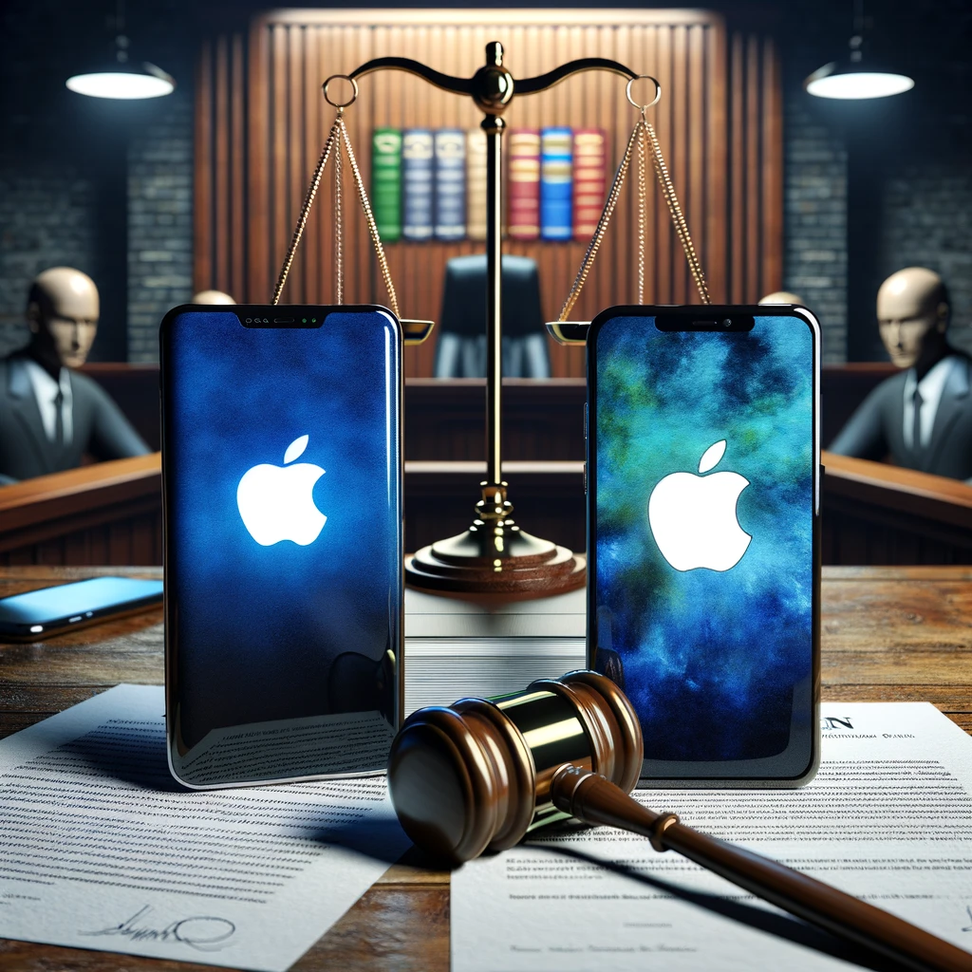
Case Study - Samsung vs. Apple Patent Dispute

Slide 41
Case Study - Samsung vs. Apple Patent Dispute
Background:
Samsung and Apple, two of the world's leading technology companies, engaged in a high-profile legal battle over patent infringement claims. The dispute began in 2011 when Apple filed a lawsuit against Samsung, alleging that Samsung’s smartphones and tablets infringed on Apple’s intellectual property, specifically patents related to the design and functionality of the iPhone and iPad.

Slide 42
Case Study - Samsung vs. Apple Patent Dispute
Issue:
The core of the dispute revolved around several Apple patents, including those for the design of the iPhone's front face, the user interface, and the iconic “pinch-to-zoom” feature.
Apple claimed that Samsung's products, such as the Galaxy series, copied the look and feel of its devices, leading to consumer confusion and unfair competition..

Slide 43
Case Study - Samsung vs. Apple Patent Dispute
Legal Proceedings:
The legal battle was fought in multiple courts around the world, but the most notable trial took place in the United States. In 2012, after a high-profile trial in California, the jury found that Samsung did infringe on Apple.s patents and awarded Apple over $1 billion in damages.
However, subsequent appeals and retrials led to adjustments in the number of damages owed.

Slide 44
Case Study - Samsung vs. Apple Patent Dispute
Resolution:
After years of litigation, Samsung and Apple agreed to settle the remaining disputes in 2018. While the exact terms of the settlement were not disclosed, it ended a significant chapter in the ongoing battle between the two tech giants.
The case highlighted the competitive nature of the technology industry and the importance of intellectual property rights.

Slide 45
Case Study - Samsung vs. Apple Patent Dispute
Conclusion:
The Samsung vs. Apple case is a landmark in the field of intellectual property law, illustrating the complexities of patent infringement in the technology sector.
It underscored the aggressive strategies companies may employ to protect their innovations and the lengthy and costly nature of patent litigation.

Slide 46
Case Study - Samsung vs. Apple Patent Dispute
Conclusion:
The dispute also sparked discussions about the need for patent system reform, particularly concerning the balance between fostering innovation and preventing anti-competitive practices.

Slide 47
Thanks Any Question ?????

